Slide 1

Test of Significance
Presented by:
Elizer Ponio Jr.
Department of Computer Science
College of Computing and Information Technologies

Slide 2
Outline
Recap of Statistical Inference
Test of Significance and Hypothesis Testing
Null and Alternate Hypothesis
Steps of Hypothesis Testing

Slide 3
Recap: Statistical Inference
Confidence intervals are one of the two most common types of statistical inference.
Researchers use a confidence interval when their goal is to estimate a population parameter.

Slide 4
Recap: Statistical Inference
The second common type of inference, called a test of significance, has a different goal:
To assess the evidence provided by data about some claim concerning a population.

Slide 5

Recap of Statistical Inference
Test of Significance and Hypothesis Testing
Null and Alternate Hypothesis
Steps of Hypothesis Testing

Slide 6
Test of Significance
A test of significance is a formal procedure for comparing observed data with a claim (also called a hypothesis), the truth of which is being assessed.
The first step in conducting a test of statistical significance is to state the hypothesis.

Slide 7
Hypothesis Testing
In today’s data-driven world, decisions are based on data all the time
Hypothesis plays a crucial role in that process, whether it may be making business decisions, in the health sector, academia, or in quality improvement.
Without hypothesis and hypothesis tests, you risk drawing the wrong conclusions and making bad decisions.

Slide 8
Hypothesis Testing
Hypothesis Testing puts our assumptions about a population parameter to the test.
It is used to estimate the relationship between two statistical variables. Real life examples include:
A teacher assumes that 60% of his college's students come from lower-middle-class families.
A doctor believes that 3D (Diet, Dose, and Discipline) is 90% effective for diabetic patients.

Slide 9
How Hypothesis Testing Works?
Measurements and analyses are conducted on a random sample of the population to test a theory.
In hypothesis testing, a decision between two alternatives must be made.
One of which is called the null hypothesis and the other the alternative hypothesis

Slide 10
Recap of Statistical Inference
Test of Significance and Hypothesis Testing
Null and Alternate Hypothesis
Steps of Hypothesis Testing

Slide 11

Null Hypothesis
The null hypothesis is a form of hypothesis that is deemed “true” until proven wrong based on experimental data.
It is defined as the commonly accepted fact (such as the sky is blue) and the researcher’s aim is to reject or nullify this fact.
The notation that is typically used for the null hypothesis is $H_{o}$

Slide 12
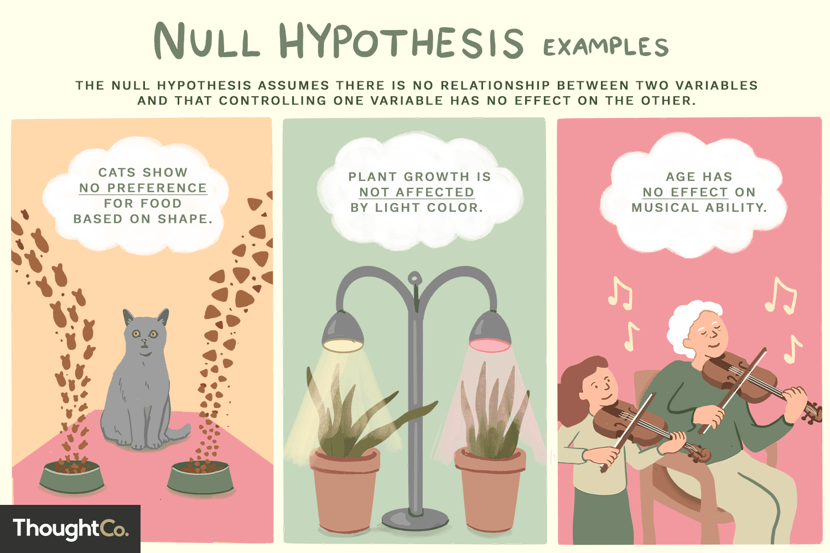

Slide 13
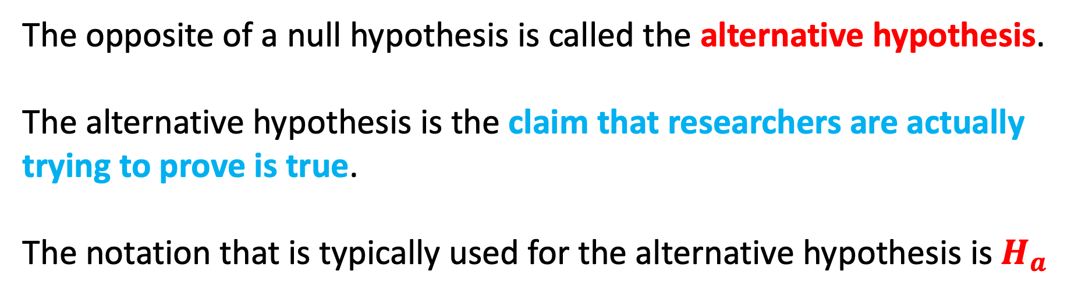
Alternative Hypothesis
The opposite of a null hypothesis is called the alternative hypothesis.
The alternative hypothesis is the claim that researchers are actually trying to prove is true.
The notation that is typically used for the alternative hypothesis is $H_{a}$

Slide 14
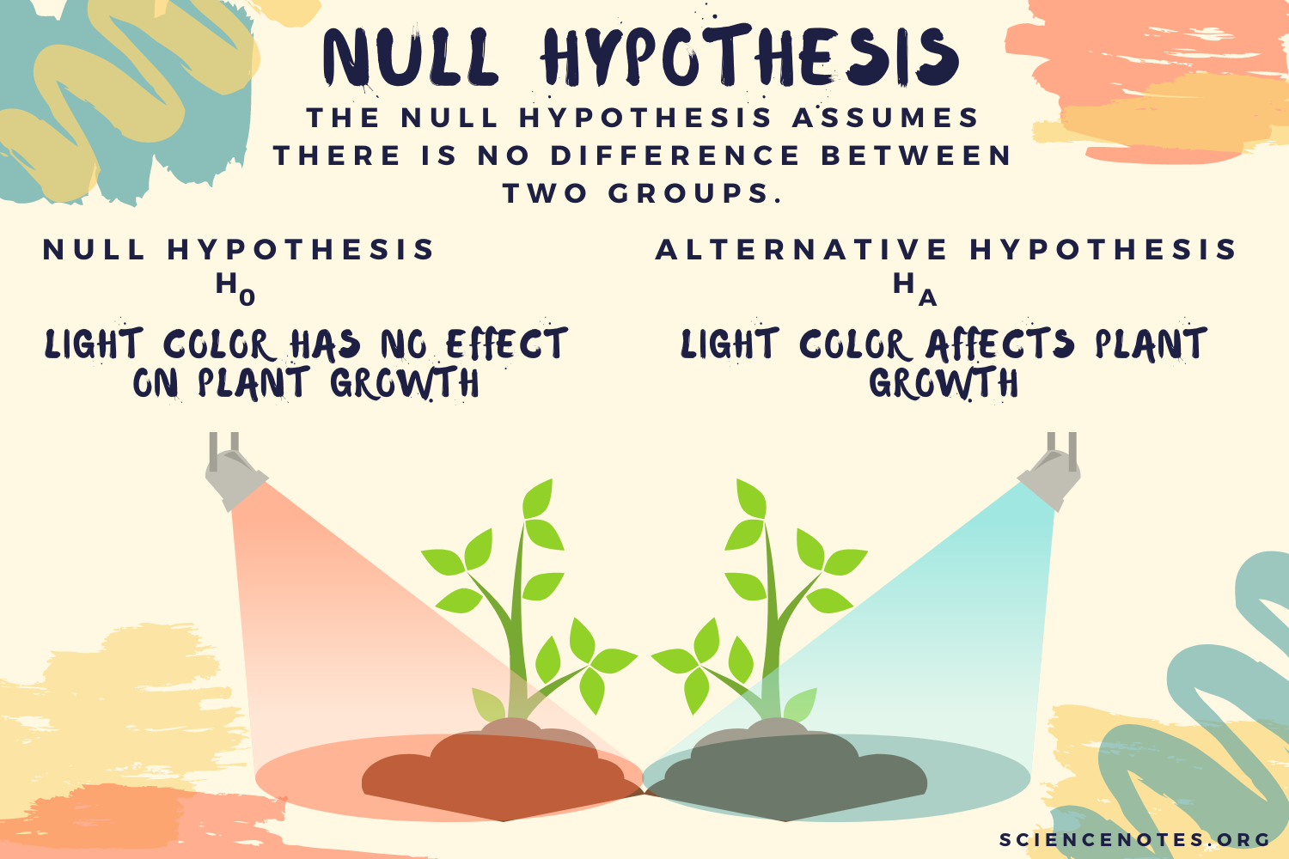

Slide 15

Court Trial Example
The process of testing hypotheses can be compared to court trials.
A person comes into court charged with a crime.

Slide 16
Court Trial Example
A jury must decide whether the person is not guilty (null hypothesis) or guilty (alternative hypothesis).

Slide 17
Court Trial Example
Even though the person is charged with the crime, at the beginning of the trial (and until the jury declares otherwise) the accused is assumed to be not guilty of the crime.
Only if overwhelming evidence of the person's guilt can be shown is the jury expected to declare the person guilty, otherwise the person is considered not guilty.

Slide 18
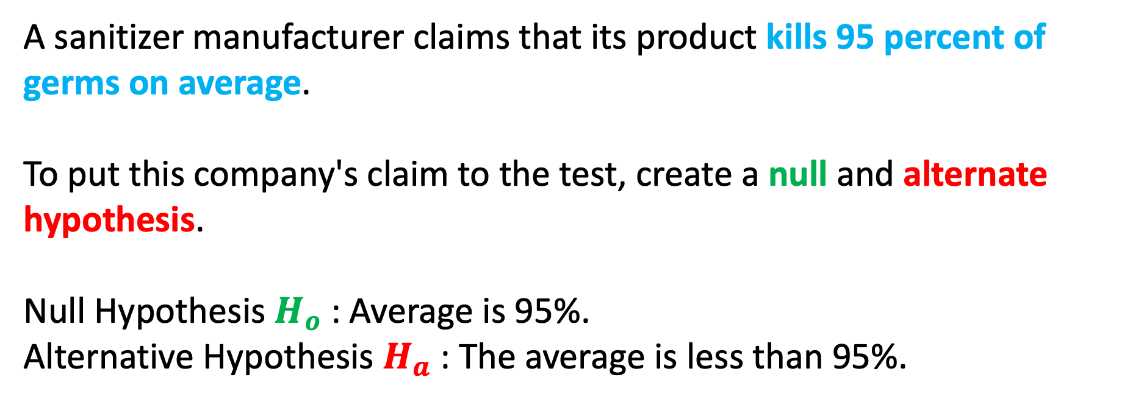
Hand Sanitizer Example
A sanitizer manufacturer claims that its product kills 95 percent of germs on average.
To put this company's claim to the test, create a null and alternate hypothesis.
Null Hypothesis $H_{o}$ : Average is 95%.
Alternative Hypothesis $H_{a}$: The average is less than 95%.

Slide 19
Test of Significance
When conducting a significance test, the goal is to provide evidence to reject the null hypothesis.
If the evidence is strong enough to reject the null hypothesis, then the alternative hypothesis can automatically be accepted.
However, if the evidence is not strong enough, researchers fail to reject the null hypothesis.

Slide 20
Recap of Statistical Inference
Test of Significance and Hypothesis Testing
Null and Alternate Hypothesis
Steps of Hypothesis Testing

Slide 21
Steps of Hypothesis Testing
In the Philippines, the average height of males is 5’4’’ or 64.8 inches with a standard deviation of 2.
We conducted a study to determine if this is true so we gather a sample of 100 males and determine that their average height is 5’5” or 66 inches.

Slide 22
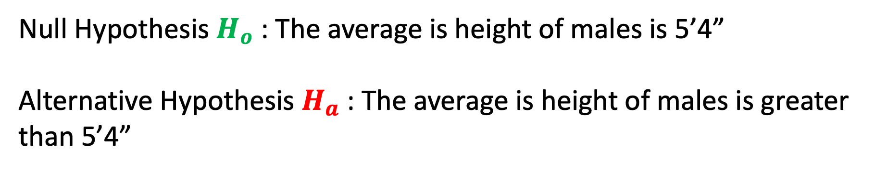
Step 1: Specify your Null and Alternate Hypothesis
Null Hypothesis $H_{o}$ : The average is height of males is 5’4”
Alternative Hypothesis $H_{a}$: The average is height of males is greater than 5’4”

Slide 23
Step 2: Gather your data
After specifying our null and alternate hypothesis, we must gather data.
In a real world setting, sampling must be done randomly.
This refers to recording the height of 100 males from different parts of the country.

Slide 24
Step 3: Conduct a statistical test
To determine whether a discovery or relationship is statistically significant, hypothesis testing uses a z-test.
It usually checks to see if the two means, the population mean and the sample mean, are the same.
Note: Only when the population standard deviation is known and the sample size is 30 data points or more, can a z-test be applied.

Slide 25

Step 3: Conduct a statistical test
$$z= \frac{\overline{x} − μ}{\frac{σ}{\sqrt{n}}}$$
Where:
$\overline{x}$ is the Population mean height
$σ$is the Population standard deviation
$μ$is the sample mean
$n is the s$ample size

Slide 26

Step 3: Conduct a statistical test
$\overline{x}$= 66 inches
$σ$= 2
$μ$= 64.8 inches
$n$= 100
$$z= \frac{66−64.8}{\frac{2}{\sqrt{100}}}$$
$$z=6.00$$

Slide 27
Step 4: Determine Rejection Of Your Null Hypothesis
A p-value is used in hypothesis testing to help you support or reject the null hypothesis.
The p-value is the evidence against a null hypothesis. The smaller the p-value, the stronger the evidence that you should reject the null hypothesis.
p-values are expressed as decimals although it may be easier to understand what they are if you convert them to a percentage. For example, a p value of 0.0254 is 2.54%.

Slide 28
Step 4: Determine Rejection Of Your Null Hypothesis
A small p (≤ 0.05), reject the null hypothesis. This is strong evidence that the null hypothesis is invalid.
A large p (> 0.05) means the alternate hypothesis is weak, so you do not reject the null hypothesis.

Slide 29
Step 4: Present your Results
We will reject the null hypothesis as the p-value of is less than 0.0001
and conclude that there is evidence to suggest that the average height of men in the Philippines is greater than 5'4".

Slide 30
Other Examples
https://online.stat.psu.edu/stat200/lesson/9/9.2/9.2.2/9.2.2.1/9.2.2.1.3

